Slide 1
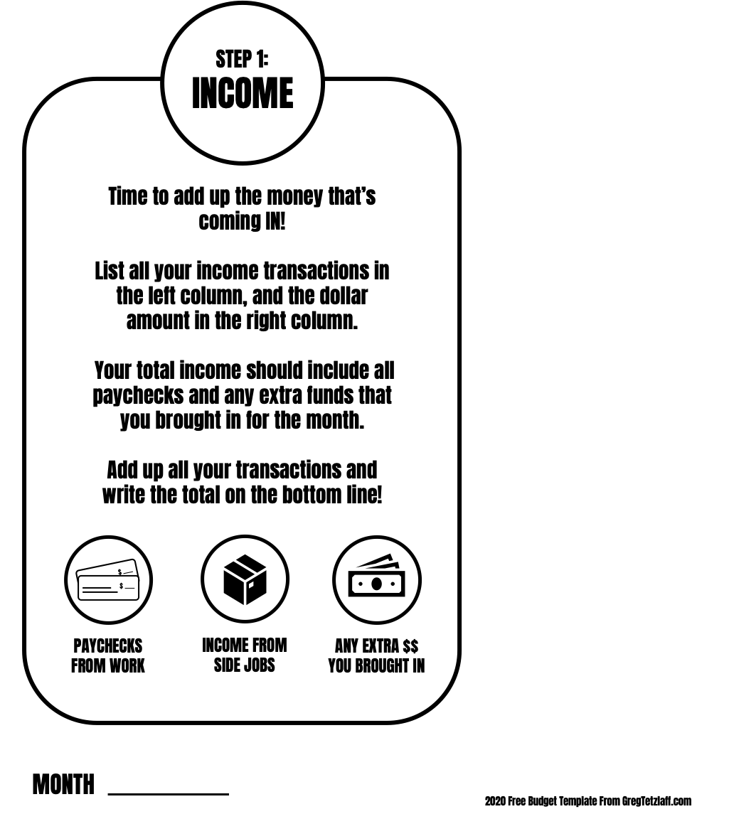
ITEM | AMOUNT
 | $
TOTAL INCOME | $

Slide 2
ITEM | AMOUNT
 | $
TOTAL FIXED EXPENSES | $

Slide 3
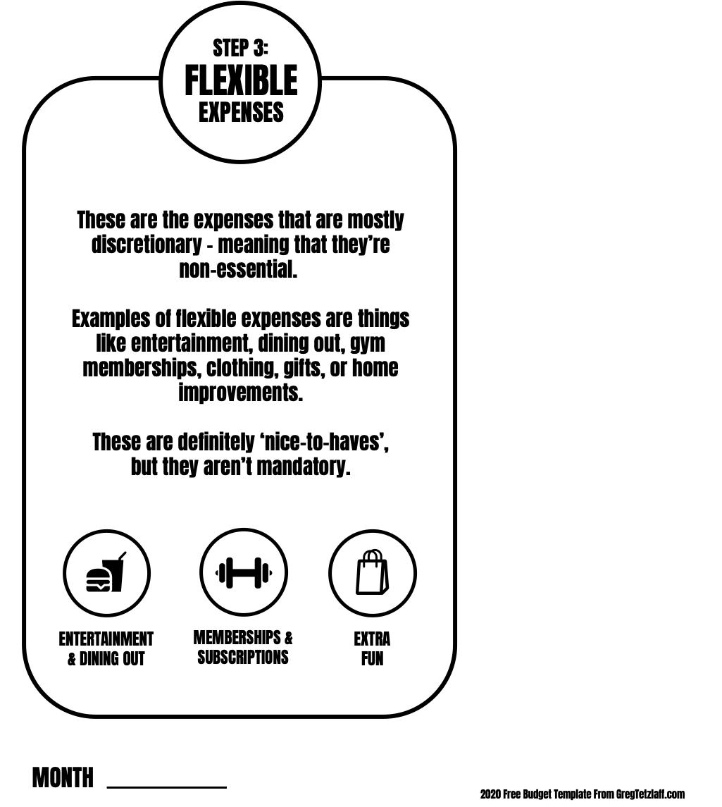
ITEM | AMOUNT
 | $
TOTAL FLEXIBLE EXPENSES | $

Slide 4
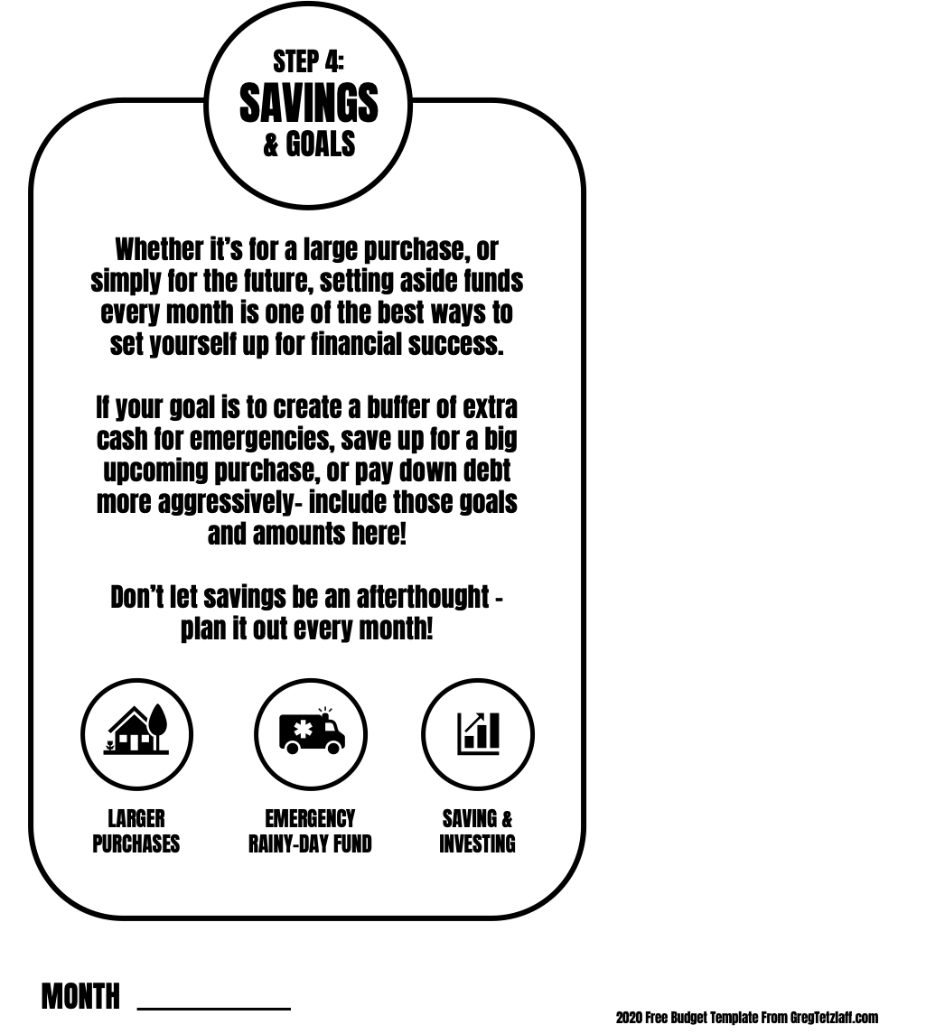
ITEM | AMOUNT
 | $
TOTAL SAVINGS & GOALS | $

Slide 5
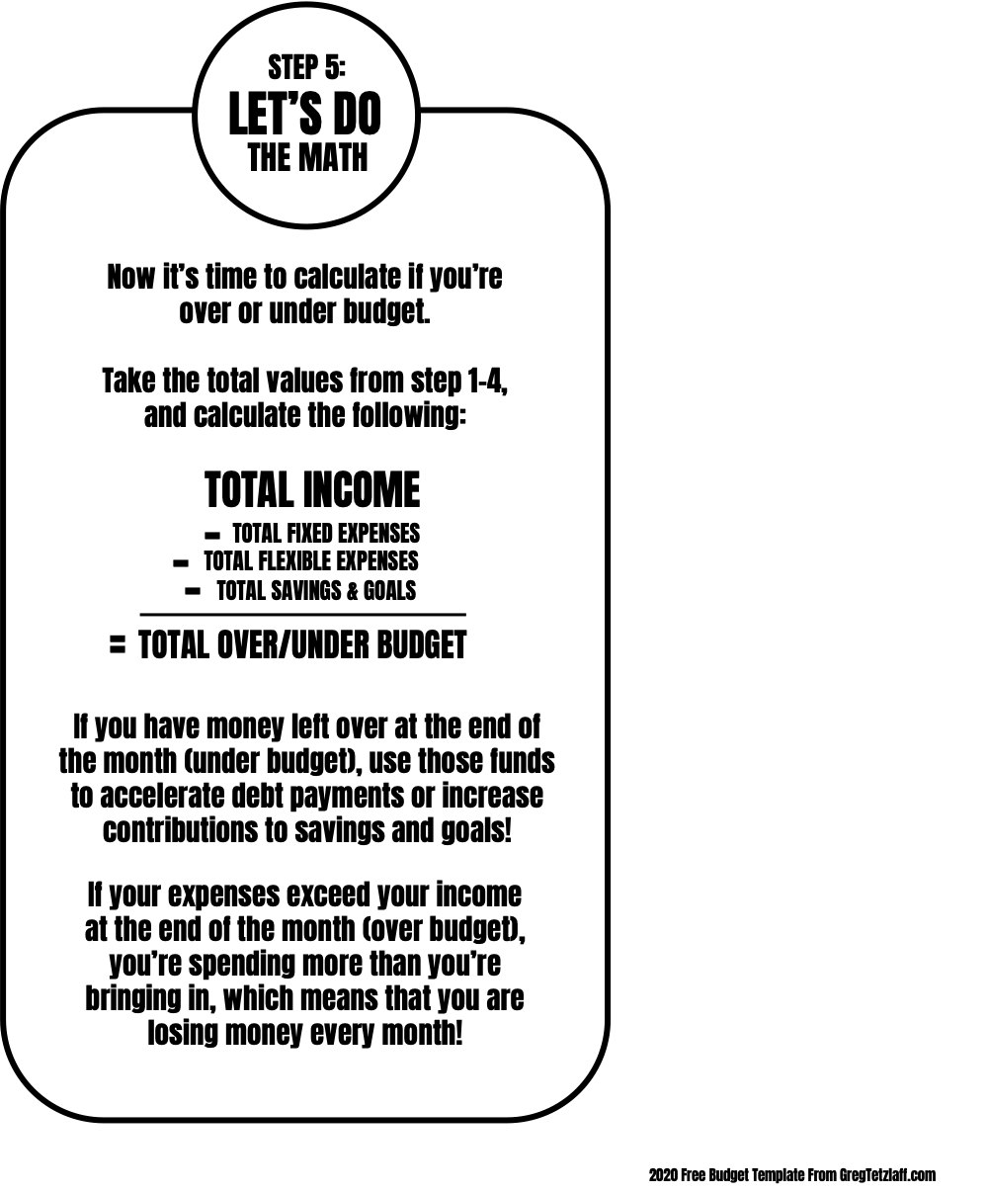
MONTH
ITEM | AMOUNT
TOTAL INCOME | $
MINUS TOTAL FIXED EXPENSES | - $
MINUS TOTAL FLEXIBLE EXPENSES | - $
MINUS TOTAL SAVINGS & GOALS | - $
TOTAL OVER/UNDER BUDGET | $

Slide 6
MONTH
ITEM | AMOUNT
TOTAL INCOME | $
BUDGET FOR FIXED EXPENSES | - $
BUDGET FOR FLEXIBLE EXPENSES | - $
BUDGET FOR SAVINGS & GOALS | - $
ALL OF THE ABOVE SHOULD EQUAL | $0.00
1
2
3
4

